Slide 1

Android
Notes:
Inroduction-
Did everyone install the android studio-
What is meant by Android –

Slide 2
Android Studio
Integrated Development Environment

Slide 3
Android SDK
Example Source code, compilers and emulators,etc.

Slide 4
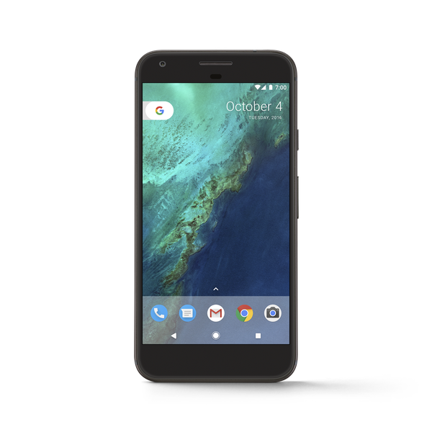
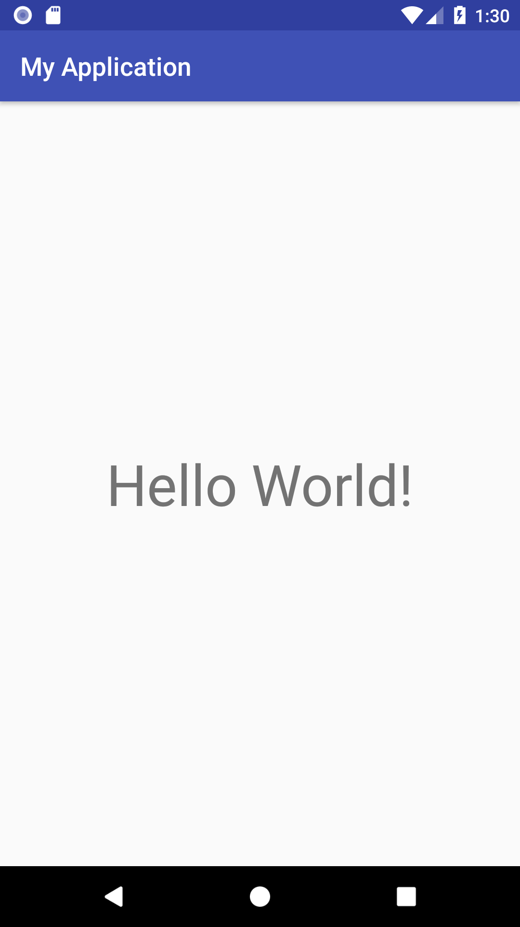
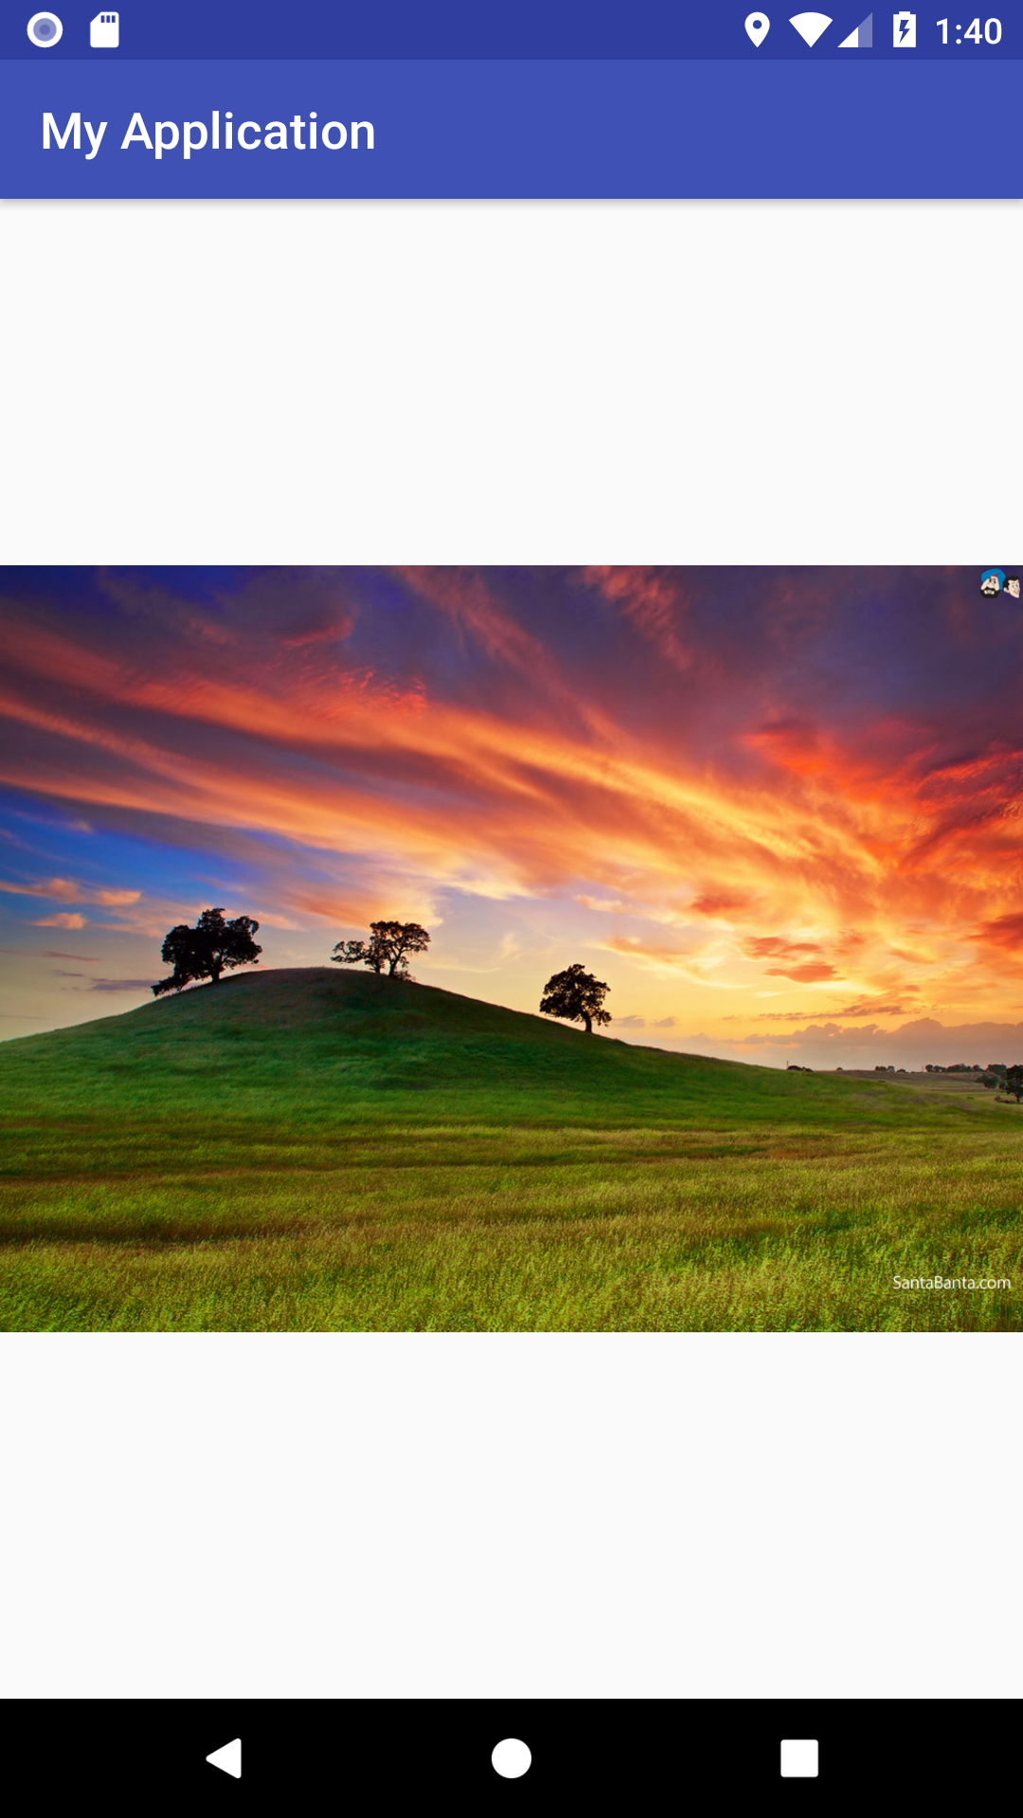
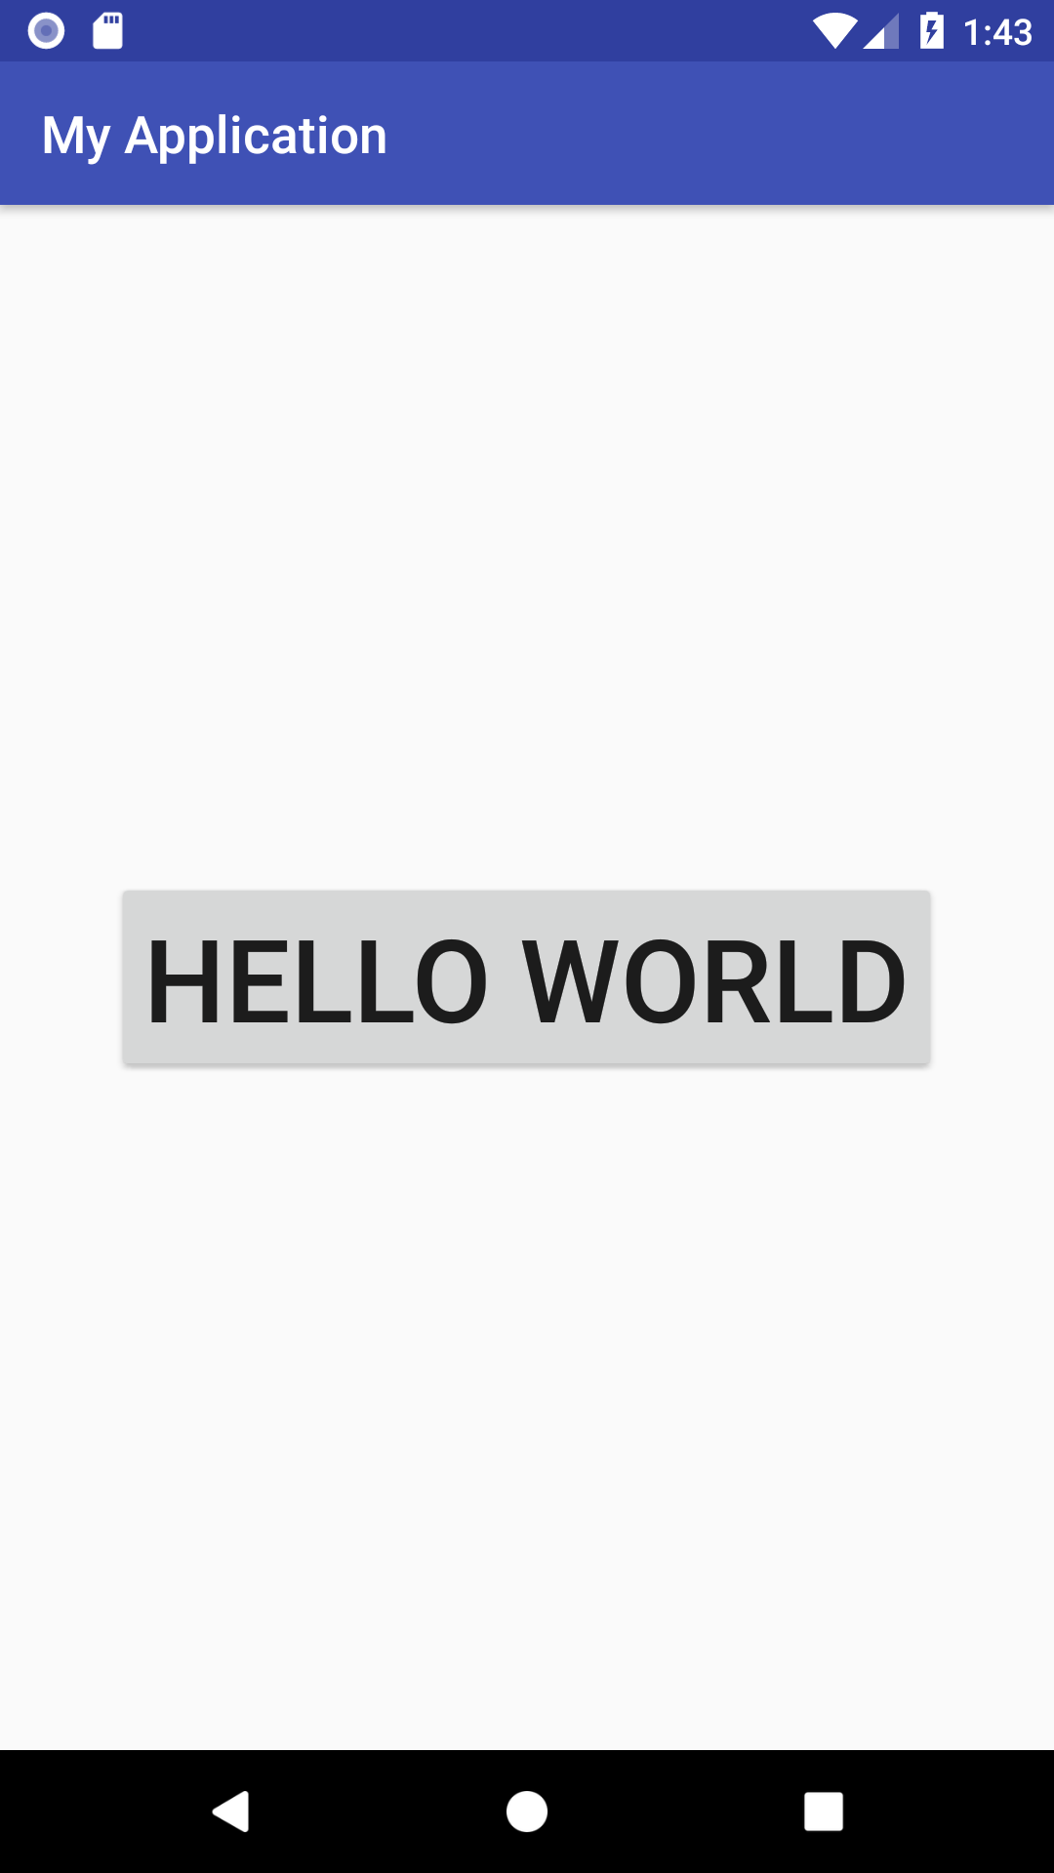
Views-
TextView
ImageView
Button

Slide 5
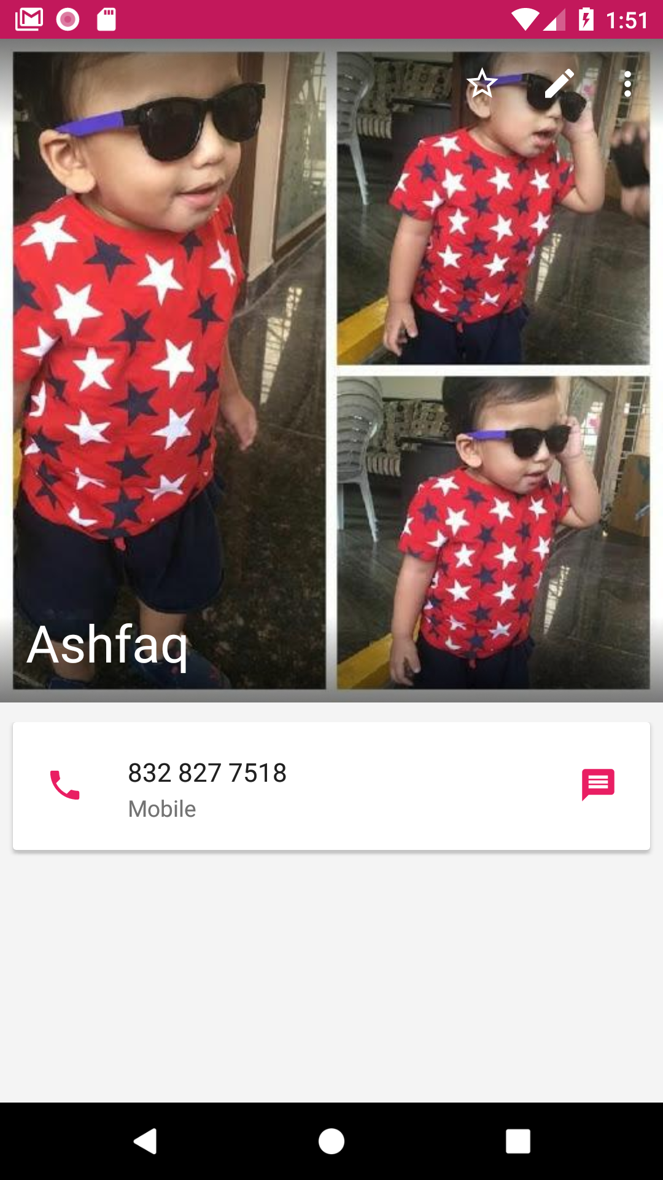
Example For View

Slide 6
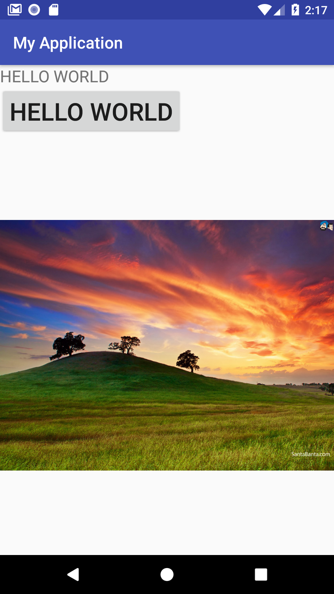
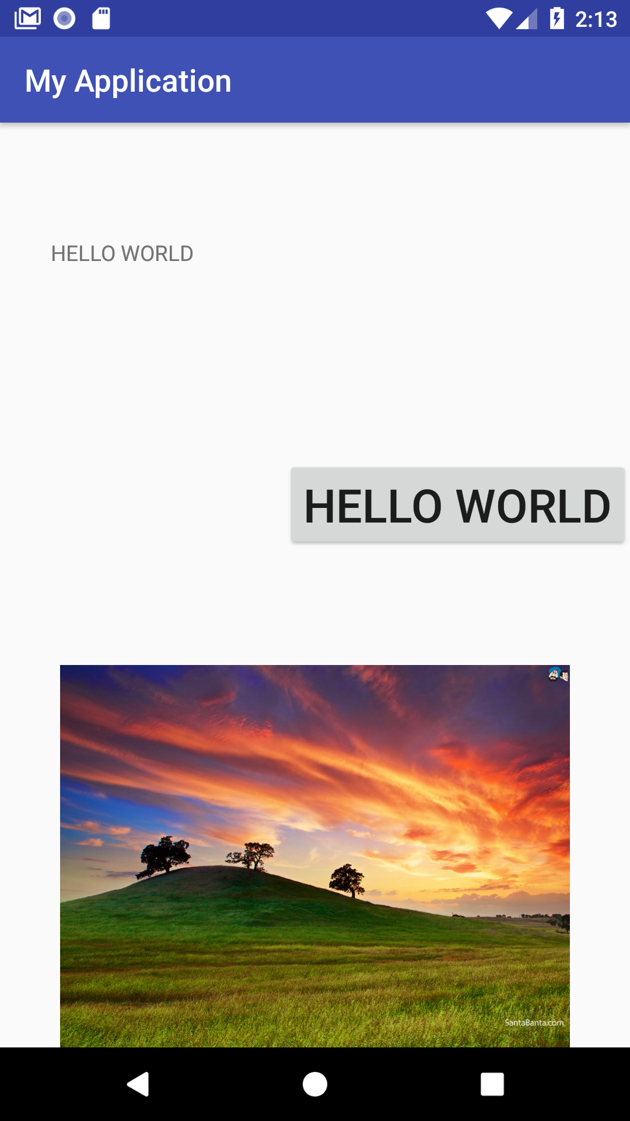
Layouts
Linear Layout
Relative Layout

Slide 7
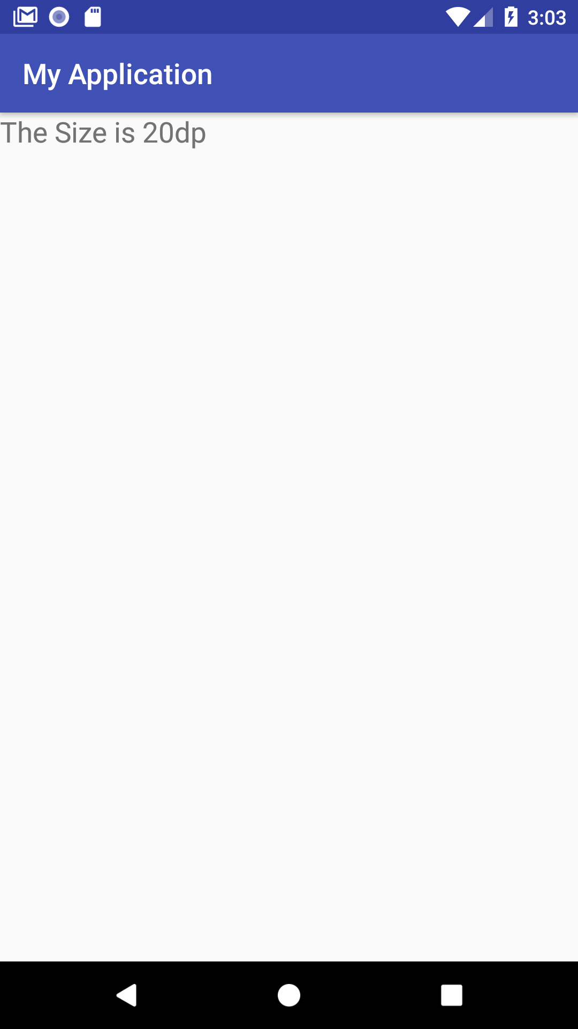
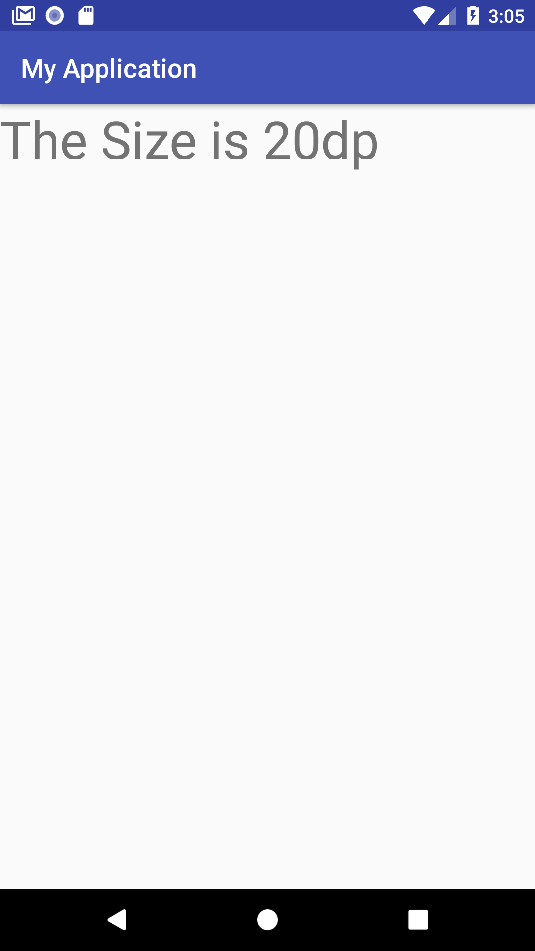
dp(density pixels)
2160X1920 Phone
1920X1080 Phone
1280X720
1280X720

Slide 8
dp(density pixels)
2160X1920 Phone
1920X1080 Phone
1920X1080
1280X720
1920X1080
1280X720

Slide 9
Padding
HELLO WORLD
HELLO WORLD
HELLO WORLD
Before Padding
After Padding

Slide 10
Layout_margin
HELLO
HELLO WORLD
layout_marginBottom
WORLD
Before layout_margin
After layout_margin

Slide 11
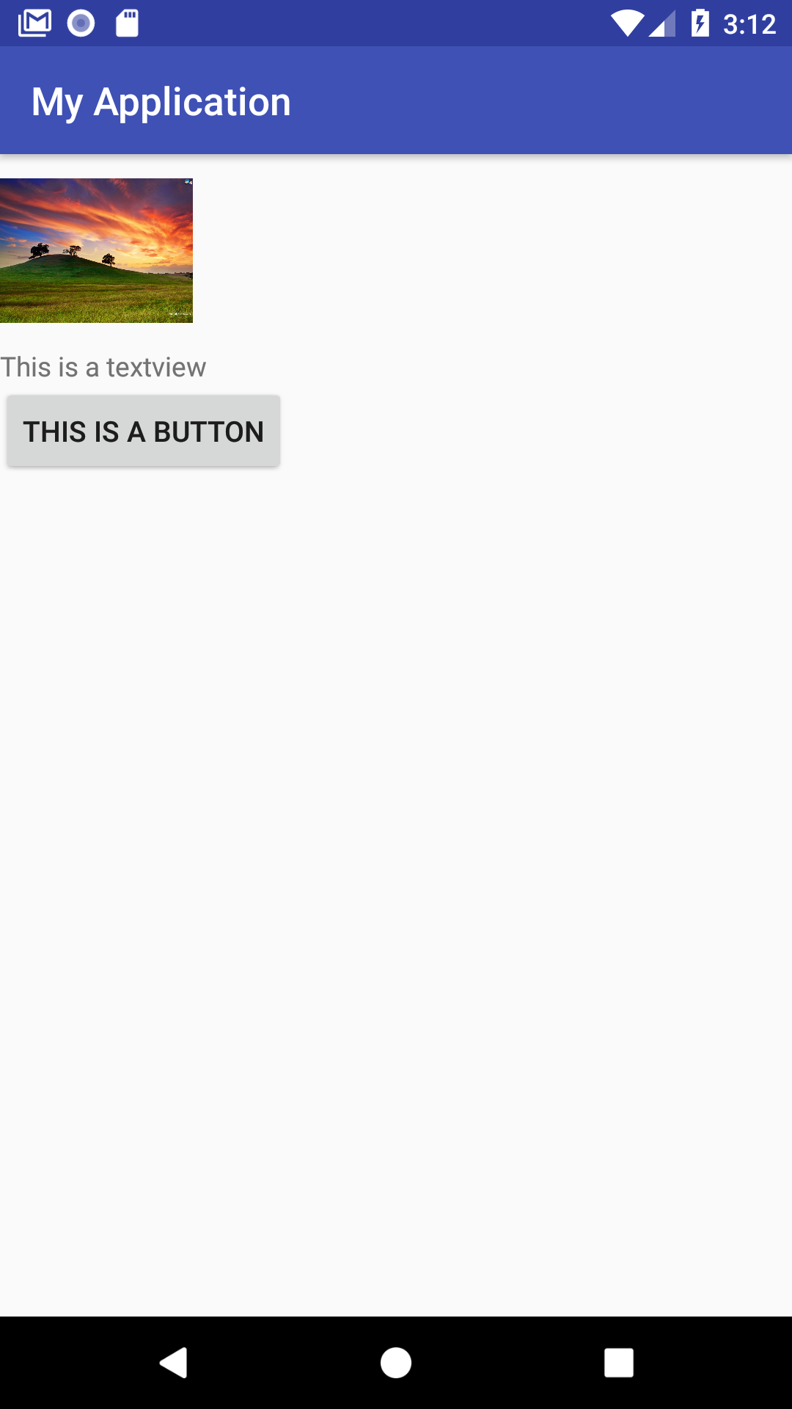
Create this layout

Slide 12
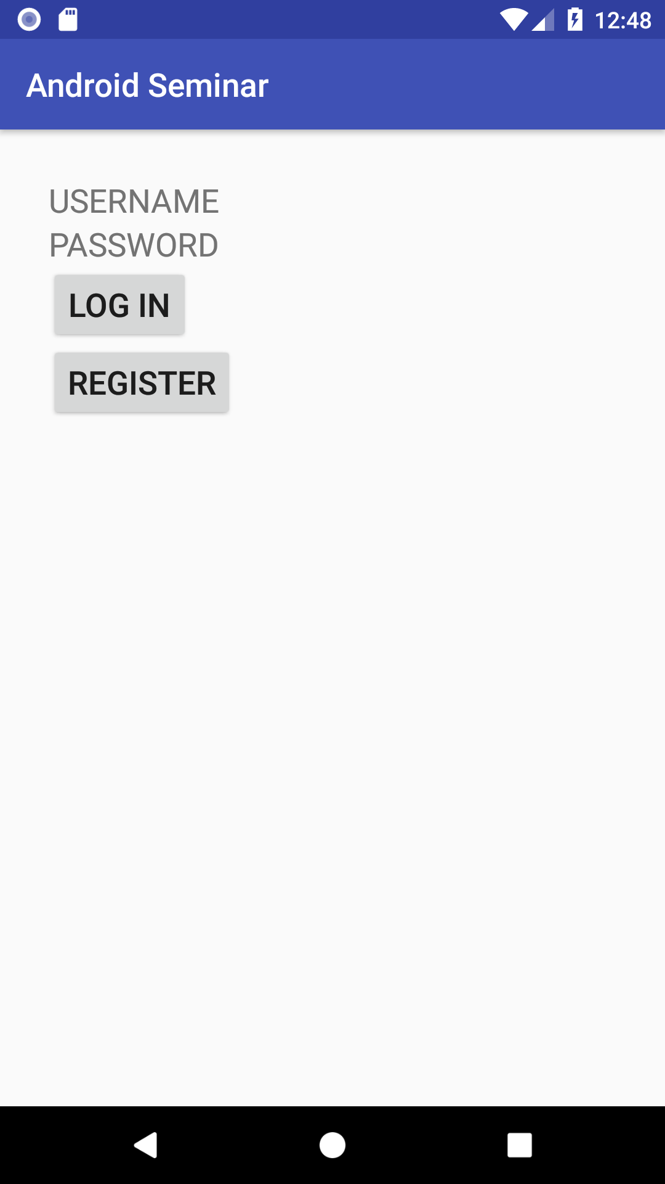
Create this Activity-
Hint-
16dp
1.Try to use Linear Layout
2.TextView
3.Button
4.Give space from the edges
16
16
16dp

Slide 13
Layout_marginBottom
USERNAME
//layout_marginBottom=10dp
USERNAME
PASSWORD
PASSWORD
//layout_marginBottom=10dp
LOGIN
LOGIN
REGISTER
//layout_marginBottom=10dp
REGISTER

Slide 14
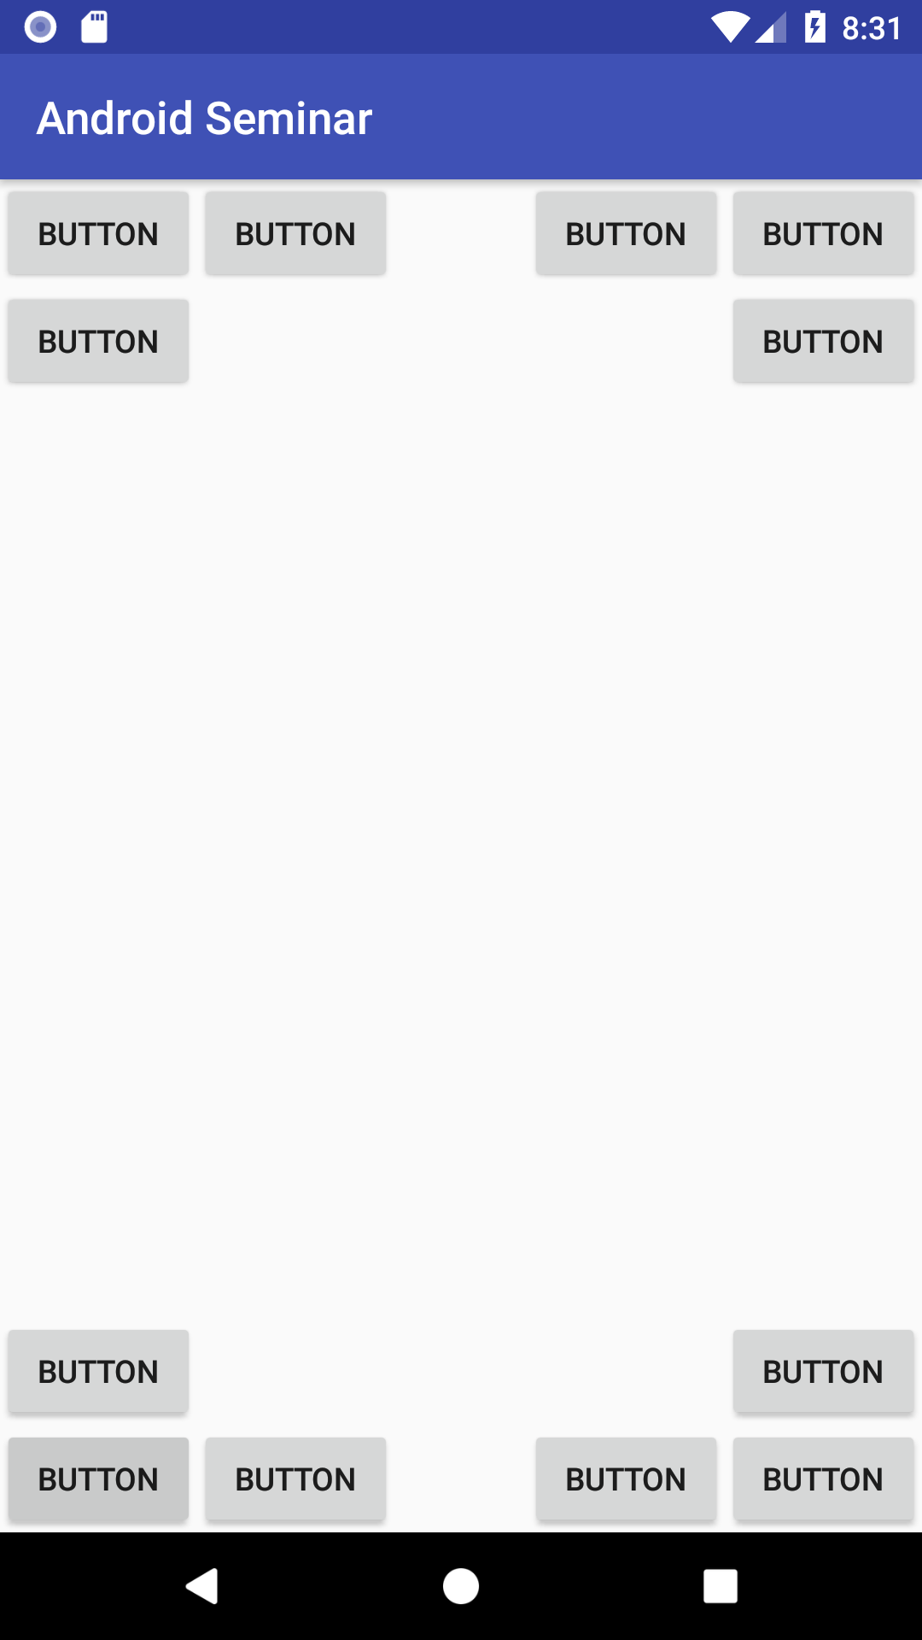
Create this layout

